Slide 1
Lists
Tutorial #18

Slide 2
OBJECTIVE

Slide 3
Objective
At the end of this tutorial, you will know how to create lists using HTML.

Slide 4
TEXTPLANATION

Slide 5
Textplanation
So many of the HTML tags still in use today were designed to format text into page design. So much of that functionality has been replaced by CSS that it makes you wonder why you have to deal with any HTML beyond <span> and <div> at all. HTML does have its design uses, though. After all, why should I have to write a whole bunch of complicated CSS to do something that HTML is already programmed to do?

Slide 6
Textplanation
Lists are a good example of this. There are 3 types of lists. There’s the ordered list, which numbers things. There’s the unordered list, which doesn’t number things. It uses bullets instead. Then there’s the definition list, which I stopped using a few years back so I’m not going to bother with it.

Slide 7
Textplanation
That leaves us with ordered and unordered lists, which, because of CSS, are essentially the same thing.

Slide 8
Textplanation
Lists themselves are container tags. Remember that term. Container. I use it a lot. I like containers. They’re objects that hold other objects inside of them. So ordered lists use the tag <ol></ol> and unordered lists use the tag <ul></ul>. Pretty simple, right? Except that these two tags don’t really do anything by themselves. They’re containers.

Slide 9
Textplanation
Like all good containers, you’re supposed to put something into them. In this case, you’re going to put list items <li></li> into them. You open up a list, put in a bunch of list items, and then close the list. If you have an ordered list, your list items will be numbered, starting at 1. If you have an unordered list, your items will be bulleted with solid dots (called discs). That may make them seem different to you, but, on a functional level, they’re really not. Using CSS, you can change the bullets to letters or roman numerals or open circles or some custom created bullet. Since the CSS properties for ordered and unordered lists are exactly the same, you can give an unordered list numbers and an ordered list dots.

Slide 10
Textplanation
That makes them the same.

Slide 11
CONSTRUCTION

Slide 12
Construction
Create a folder somewhere on your drive and label it Lists.
Open up notepad++.
Save the empty file to your folder and name the file “index.html”.
All first pages on a website are called index.
As you go through the images of the construction, add to your code. You will see comments with explanations of what you are doing. Those comments will change with each slide. You should not type my comments into your code.

Slide 13
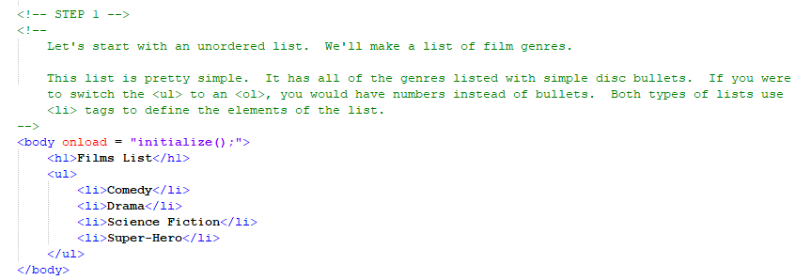
Construction

Slide 14
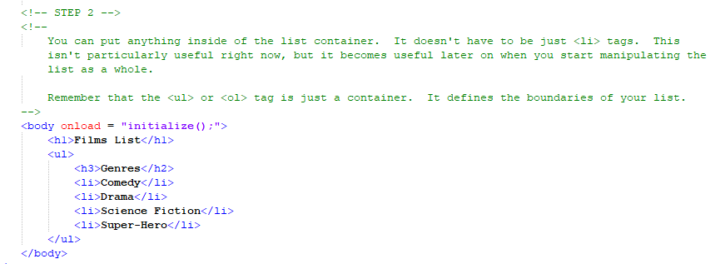
Construction

Slide 15
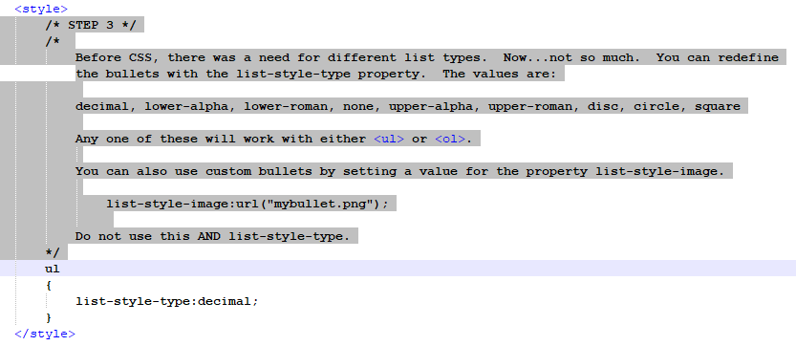
Construction

Slide 16
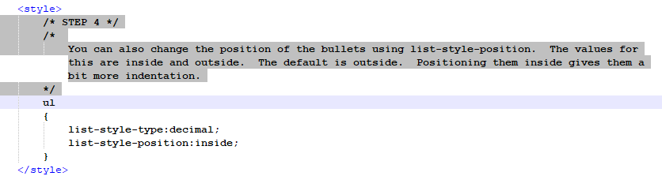
Construction

Slide 17
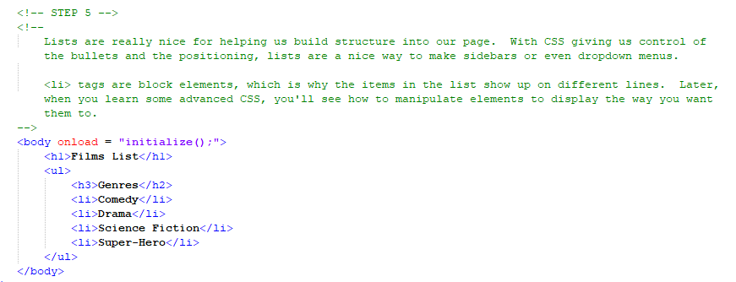
Construction

Slide 18
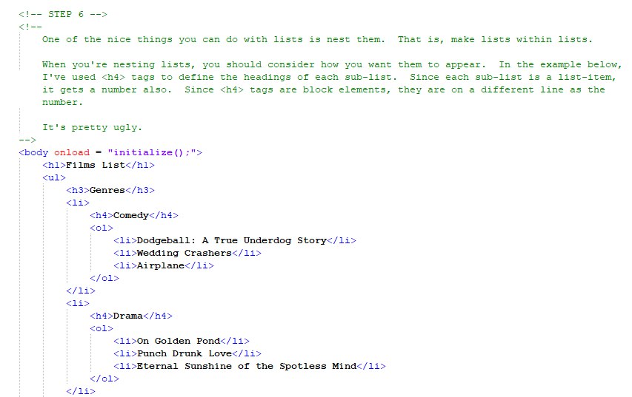
Construction

Slide 19
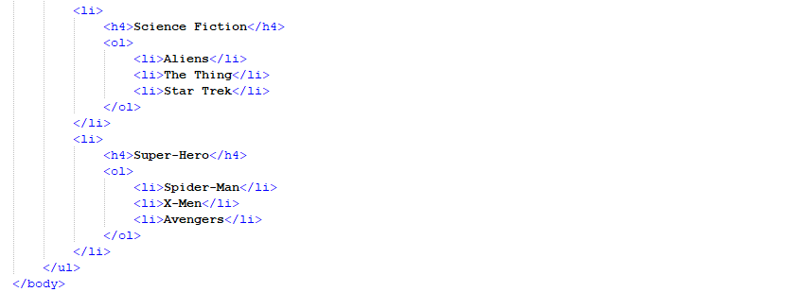

Slide 20
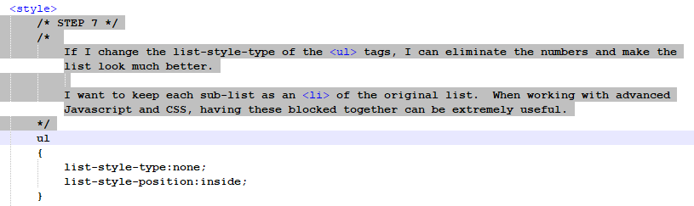
Construction

Slide 21
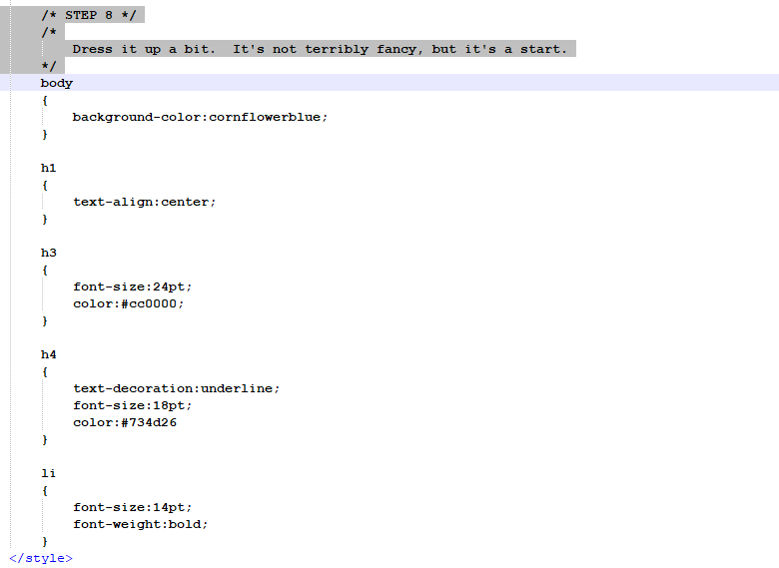
Construction

Slide 22
A DEEPER MEANING

Slide 23
A Deeper Meaning
Lists probably seem pretty simple, and they are. Like everything else, it’s not how to to use them, but how you use them. It’s like a game. There are numerous cards in your deck, but the strength of the player comes out as you combo them. What happens when you put a list inside of a list? Can you style the different lists differently to give your user a more distinct experience?

Slide 24
A Deeper Meaning
In addition to straight-up lists, web programmers use the list tags for a variety of things. The most notable of all of them is dropdown menus. We’ll do those later when we have some more advanced CSS in our toolboxes, but the list itself works as a great base. You don’t have to worry about defining <div>s and <span>s that you might be using elsewhere, and the container keeps all of your elements in one group. These really comes in handy later when you’re breaking down objects by who their parents are.

Slide 25
FAQ

Slide 26
FAQ
Are there questions today?
No.

Slide 27
ACTIVITY

Slide 28
Dynamic List
Let’s build a page where a user can create and update his or her own list.
Create a header with the word “untitled”.
Create a list with 5 items. Each item should say “undefined”.
Add a textbox and 6 buttons. The textbox should be empty, but the buttons should read Title, 1st item, 2nd item, 3rd item, 4th item, 5th item.
Each time the user clicks on one of the buttons, the page will update the list (or the title) with whatever is typed in the textbox.
Dress it up with a little CSS.

